Slide 1
Practice of CSE and DIK
18ESC108A Elements of Computer Science and Engineering
B. Tech. 2018
Ami Rai
Roopa G
Chaitra S
Department of Computer Science and Engineering
Faculty of Engineering and Technology
Ramaiah University of Applied Sciences

Slide 2
Objectives
At the end of this lecture, student will be able to
Identify and appreciate the need to study Elements of CSE for his/her professional development
Explain the practices of computer science engineers in research and prototyping domain
Identify the practices of computer science engineers in software development and testing domain
Explain the data, information and knowledge pyramid

Slide 3
Topics
Practice of CSE
Data, Information and Knowledge

Slide 4
Need for Elements of CSE
Q. Why should every Engineer study the Elements of CSE?
For developing computational routines for solving engineering problems
Mostly numerical computation
But also need data processing, communication and user interface
More complete applications would need development by a (large) team over multiple stages (versions)
Need an understanding of software development process
Able to integrate the developed software into an application
Be part of developer team (most engineering jobs are software development in nature)

Slide 5
Need for Elements of CSE, Contd.
As future professional technical leader and manager required to make decisions involving answering
What aspect of the problem is computational in nature?
What should be delegated to dedicated software developers?
What would be the effort involved in the development process?
What should be the specifications and functionality of the software?
...
Hence, exposure to the nature and practice of CSE is a required foundation for future engineer professionals
Computer programming ability is an core requirement
Exposure to modern computing systems and CSE methods is essential, too

Slide 6
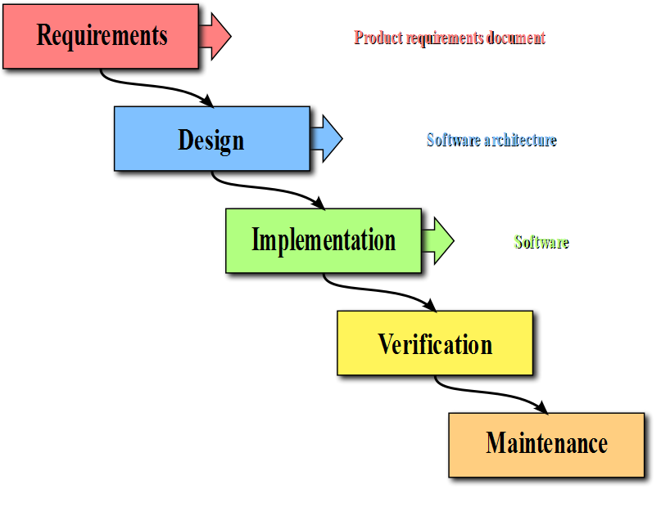
Development and Testing

Slide 7
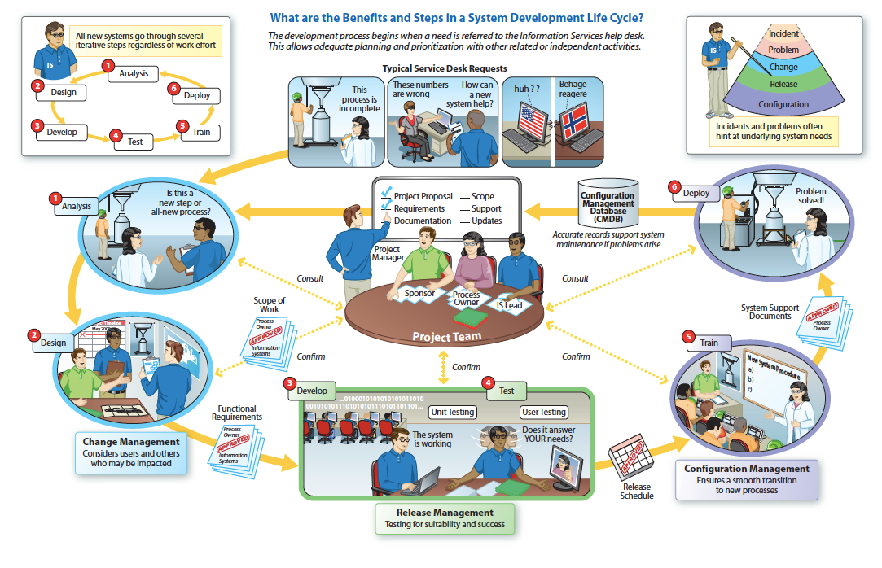
Complete Practice of CSE
Source: http://visualtranslations.com/images/1_ITILvisuals/ITIL_software_dev_lifecycle.jpeg

Slide 8
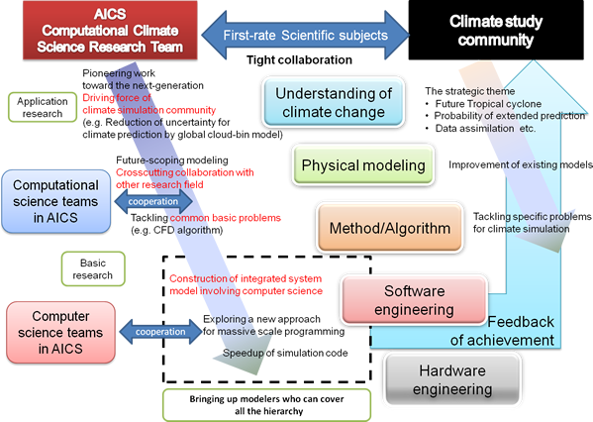
Research and Development
Example: Climate Modeling and Simulation
Source : http://aics-research.riken.jp/img/tomita_e.png

Slide 9
Data, Information and Knowledge
The DIK Pyramid represents the relationships between data, information, and knowledge
Knowledge
Information
Data

Slide 10
Data, Information and Knowledge contd.
Data is comprised of the basic, unrefined, and generally unfiltered information
Data are elements of analysis
Data must be organized to become information
Information is much more refined data that has evolved to the point of being useful for some form of analysis
Knowledge resides in the user happens only when human experience and insight is applied to data and information

Slide 11
Summary
There are several reasons for every engineer to studying CSE: From need to develop numerical computational routines, through interfacing applications to developing complex applications
Computer Science and engineering is used in two types of practices: Namely: Research and Development and Computerized Solutions
Research and Development practices demand domain specific integration of computer engineering practices
Data are elements of analysis
Information is much more refined data that has evolved to the point of being useful for some form of analysis
Knowledge resides in the user happens only when human experience and insight is applied to data and information

